Slide 1

Working with Timestamps

Slide 2
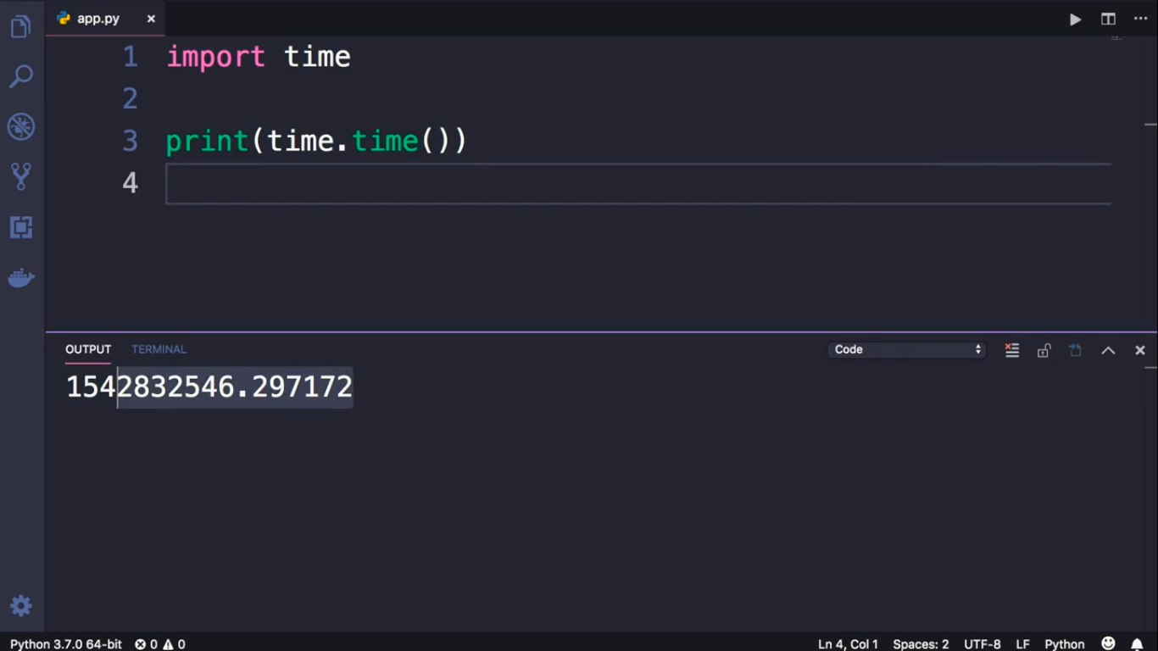
Current time in seconds

Slide 3
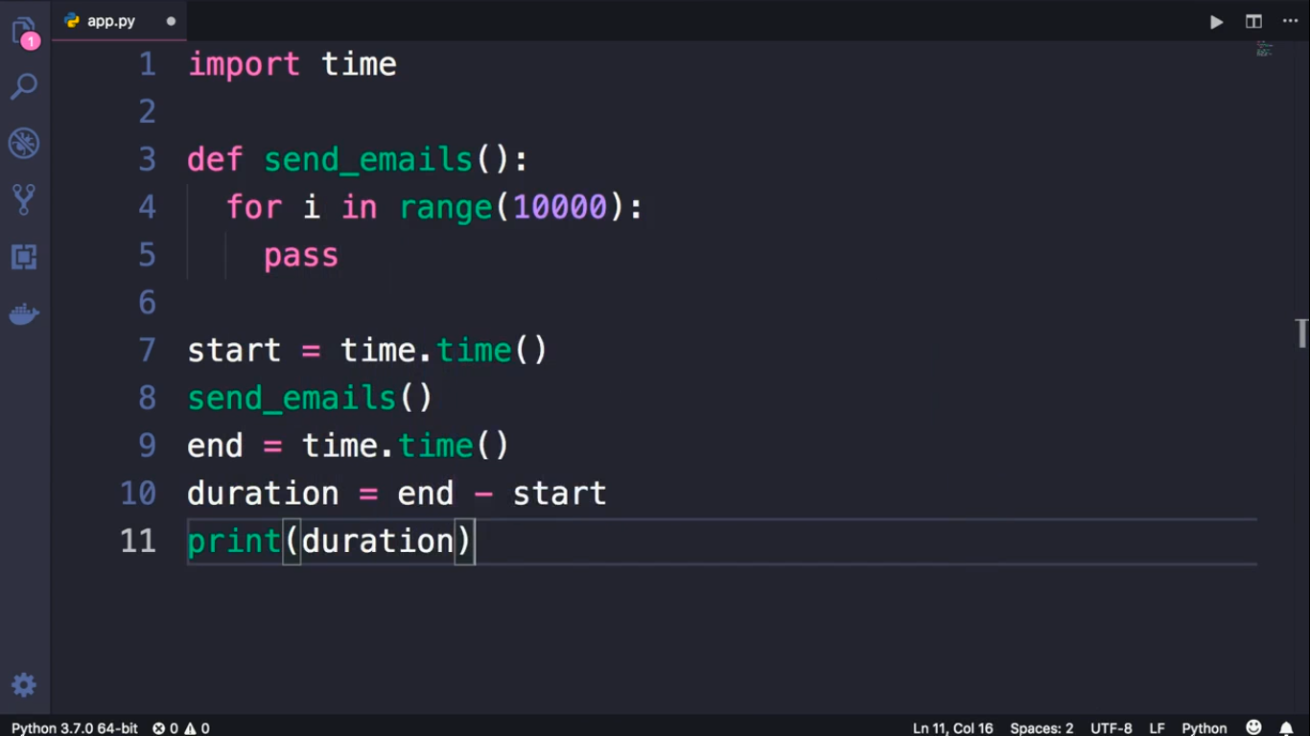

Slide 4
